Slide 1
Principal Component Analysis
CS771: Introduction to Machine Learning
Purushottam Kar

Slide 2

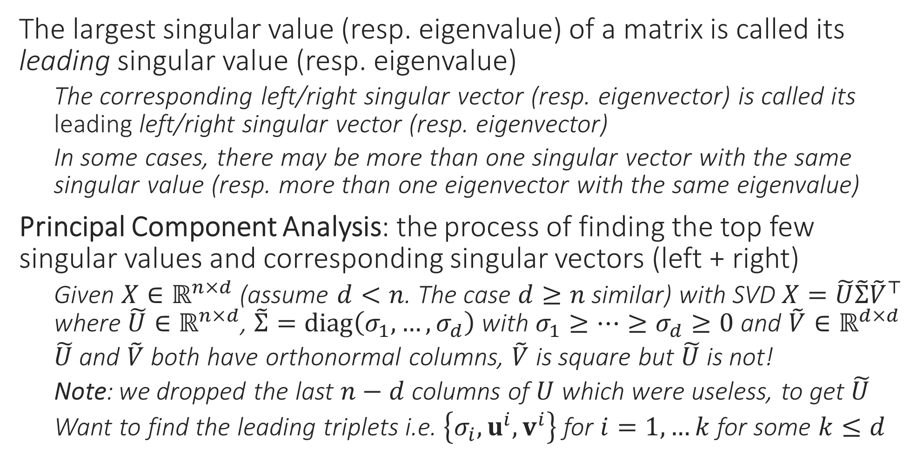
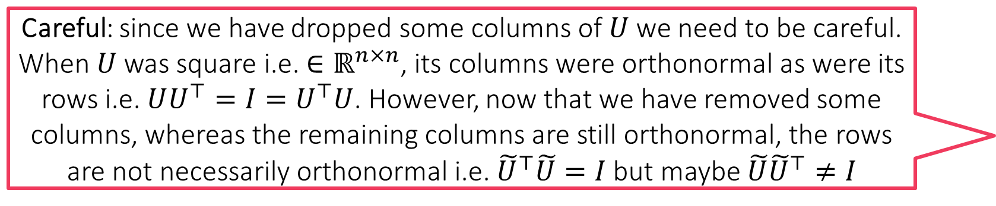
Principal Component Analysis
Careful: since we have dropped some columns of $U$ we need to be careful. When $U$ was square i.e. ${∈ℝ}^{n×n}$, its columns were orthonormal as were its rows i.e. $UU^{⊤}=I=U^{⊤}U$. However, now that we have removed some columns, whereas the remaining columns are still orthonormal, the rows are not necessarily orthonormal i.e. ${\tilde{U}}^{⊤}\tilde{U}=I$ but maybe $\tilde{U}{\tilde{U}}^{⊤}≠I$
The largest singular value (resp. eigenvalue) of a matrix is called its leading singular value (resp. eigenvalue)
The corresponding left/right singular vector (resp. eigenvector) is called its leading left/right singular vector (resp. eigenvector)
In some cases, there may be more than one singular vector with the same singular value (resp. more than one eigenvector with the same eigenvalue)
Principal Component Analysis: the process of finding the top few singular values and corresponding singular vectors (left + right)
Given $X∈ℝ^{n×d}$ (assume $d<n$. The case $d≥n$ similar) with SVD $X=\tilde{U}\tilde{Σ}{\tilde{V}}^{⊤}$ where $\tilde{U}∈ℝ^{n×d}$, $\tilde{Σ}=diag\left(σ_{1},…,σ_{d}\right)$ with $σ_{1}≥…≥σ_{d}≥0$ and $\tilde{V}∈ℝ^{d×d}$
$\tilde{U}$ and $\tilde{V}$ both have orthonormal columns, $\tilde{V}$ is square but $\tilde{U}$ is not!
Note: we dropped the last $n−d$ columns of $U$ which were useless, to get $\tilde{U}$
Want to find the leading triplets i.e. $\left\{σ_{i},u^{i},v^{i}\right\}$ for $i=1,…k$ for some $k≤d$

Slide 3
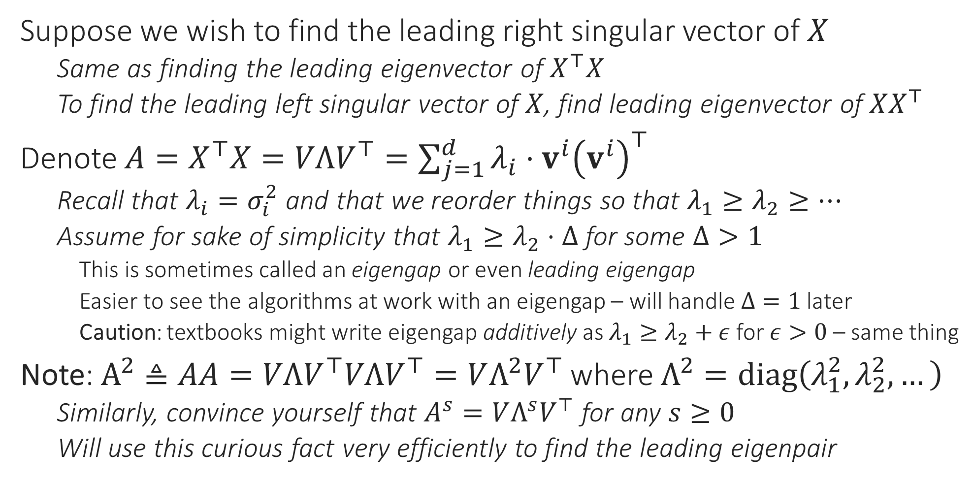
Principal Component Analysis
Suppose we wish to find the leading right singular vector of $X$
Same as finding the leading eigenvector of $X^{⊤}X$
To find the leading left singular vector of $X$, find leading eigenvector of $XX^{⊤}$
Denote $A=X^{⊤}X=VΛV^{⊤}=\sum_{j=1}^{d}{λ_{i}⋅v^{i}{\left(v^{i}\right)}^{⊤}}$
Recall that $λ_{i}=σ_{i}^{2}$ and that we reorder things so that $λ_{1}≥λ_{2}≥…$
Assume for sake of simplicity that $λ_{1}≥λ_{2}⋅Δ$ for some $Δ>1$
This is sometimes called an eigengap or even leading eigengap
Easier to see the algorithms at work with an eigengap – will handle $Δ=1$ later
Caution: textbooks might write eigengap additively as $λ_{1}≥λ_{2}+ε$ for $ε>0$ – same thing
Note: $A^{2}≜AA=VΛV^{⊤}VΛV^{⊤}=VΛ^{2}V^{⊤}$ where $Λ^{2}=diag\left(λ_{1}^{2},λ_{2}^{2},…\right)$
Similarly, convince yourself that $A^{s}=VΛ^{s}V^{⊤}$ for any $s≥0$
Will use this curious fact very efficiently to find the leading eigenpair

Slide 4


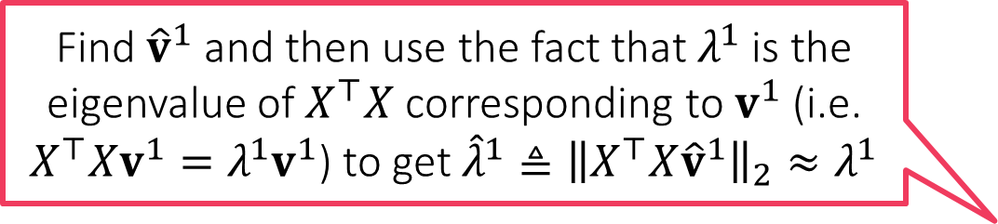
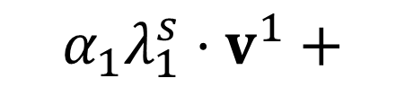

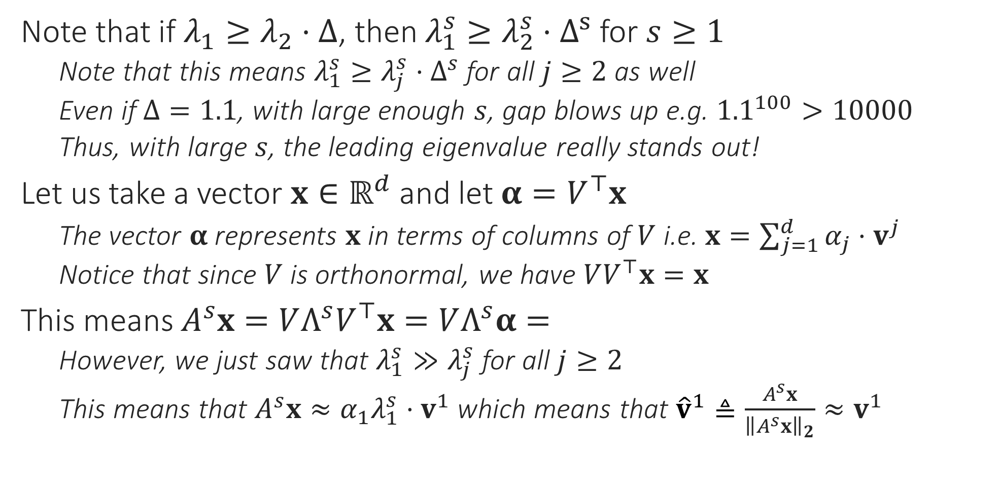

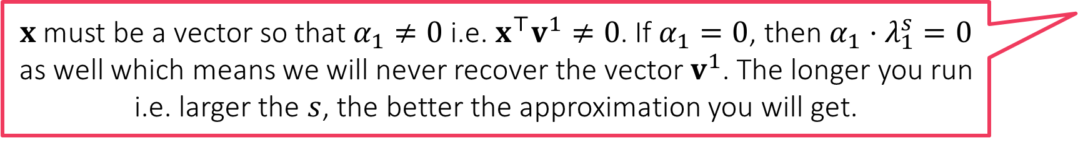
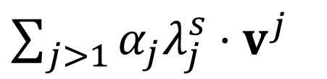

The Power Method
How do I find our $λ_{1}$?
Note that if $λ_{1}≥λ_{2}⋅Δ$, then $λ_{1}^{s}≥λ_{2}^{s}⋅Δ^{s}$ for $s≥1$
Note that this means $λ_{1}^{s}≥λ_{j}^{s}⋅Δ^{s}$ for all $j≥2$ as well
Even if $Δ=1.1$, with large enough $s$, gap blows up e.g. ${1.1}^{100}>10000$
Thus, with large $s$, the leading eigenvalue really stands out!
Let us take a vector $x∈ℝ^{d}$ and let $α=V^{⊤}x$
The vector $α$ represents $x$ in terms of columns of $V$ i.e. $x=\sum_{j=1}^{d}{α_{j}⋅v^{j}}$
Notice that since $V$ is orthonormal, we have $VV^{⊤}x=x$
This means $A^{s}x=VΛ^{s}V^{⊤}x=VΛ^{s}α=$
However, we just saw that $λ_{1}^{s}≫λ_{j}^{s}$ for all $j≥2$
This means that $A^{s}x≈α_{1}λ_{1}^{s}⋅v^{1}$ which means that ${\hat{v}}^{1}≜\frac{A^{s}x}{{\left\|A^{s}x\right\|}_{2}}≈v^{1}$
Hmm … this means if our approximation ${\hat{v}}^{1}$ is not good then our approximation ${\hat{λ}}^{1}$ wont be good either
Find ${\hat{v}}^{1}$ and then use the fact that $λ^{1}$ is the eigenvalue of $X^{⊤}X$ corresponding to $v^{1}$ (i.e. $X^{⊤}Xv^{1}=λ^{1}v^{1}$) to get ${\hat{λ}}^{1}≜{\left\|X^{⊤}X{\hat{v}}^{1}\right\|}_{2}≈λ^{1}$
$x$ must be a vector so that $α_{1}≠0$ i.e. $x^{⊤}v^{1}≠0$. If $α_{1}=0$, then $α_{1}⋅λ_{1}^{s}=0$ as well which means we will never recover the vector $v^{1}$. The longer you run i.e. larger the $s$, the better the approximation you will get.
$$α_{1}λ_{1}^{s}⋅v^{1}+$$
$\sum_{j>1}{α_{j}λ_{j}^{s}⋅v^{j}}$
We obtained our approximation as ${\hat{v}}^{1}≜\frac{A^{s}x}{{\left\|A^{s}x\right\|}_{2}}$. How should we choose $x$? Will any $x$ work? How should we choose $s$?

Slide 5
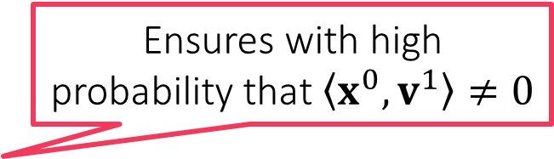
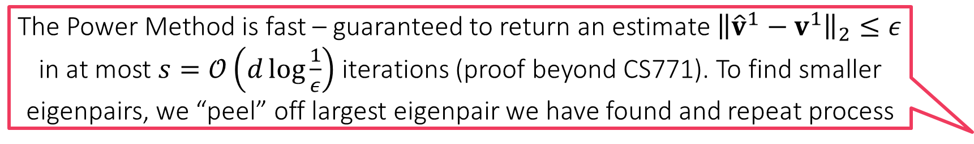
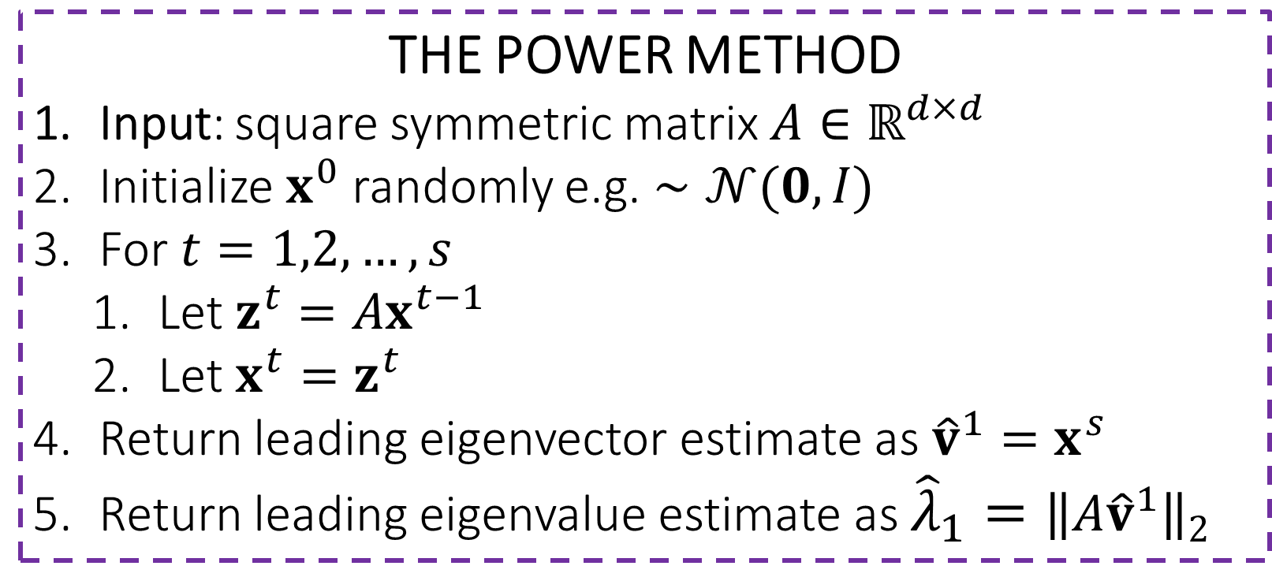
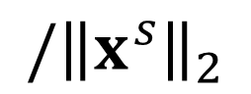
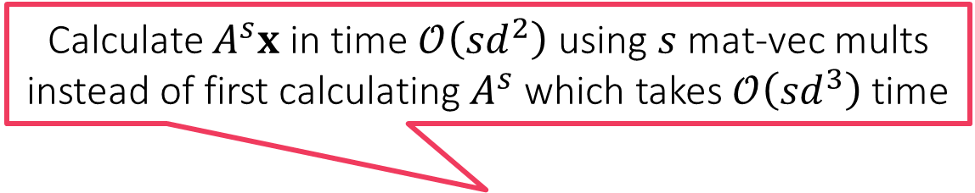
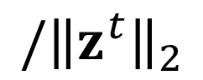
The Power Method
THE POWER METHOD
Input: square symmetric matrix $A∈ℝ^{d×d}$
Initialize $x^{0}$ randomly e.g. $∼𝒩(0,I)$
For $t=1,2,…,s$
Let $z^{t}=Ax^{t−1}$
Let $x^{t}=z^{t}$
Return leading eigenvector estimate as ${\hat{v}}^{1}=x^{s}$
Return leading eigenvalue estimate as ${{\hat{λ}}_{1}=\left\|A{\hat{v}}^{1}\right\|}_{2}$
Calculate $A^{s}x$ in time $𝒪\left(sd^{2}\right)$ using $s$ mat-vec mults instead of first calculating $A^{s}$ which takes $𝒪\left({sd}^{3}\right)$ time
Ensures with high probability that $\left\langle x^{0},v^{1}\right\rangle ≠0$
Good to periodically normalize to prevent overflow errors
$$/{\left\|z^{t}\right\|}_{2}$$
Can show that doesn’t affect the working of the algo in any way
$$/{\left\|x^{s}\right\|}_{2}$$
The Power Method is fast – guaranteed to return an estimate ${\left\|{\hat{v}}^{1}−v^{1}\right\|}_{2}≤ε$ in at most $s=𝒪\left(d\log{\frac{1}{ε}}\right)$ iterations (proof beyond CS771). To find smaller eigenpairs, we “peel” off largest eigenpair we have found and repeat process
In settings with no eigengap, it turns out that there is an entire subspace (i.e. infinitely many eigenvectors) corresponding to the largest eigenvalue
Power Method will return some vector in that subspace but not sure which

Slide 6
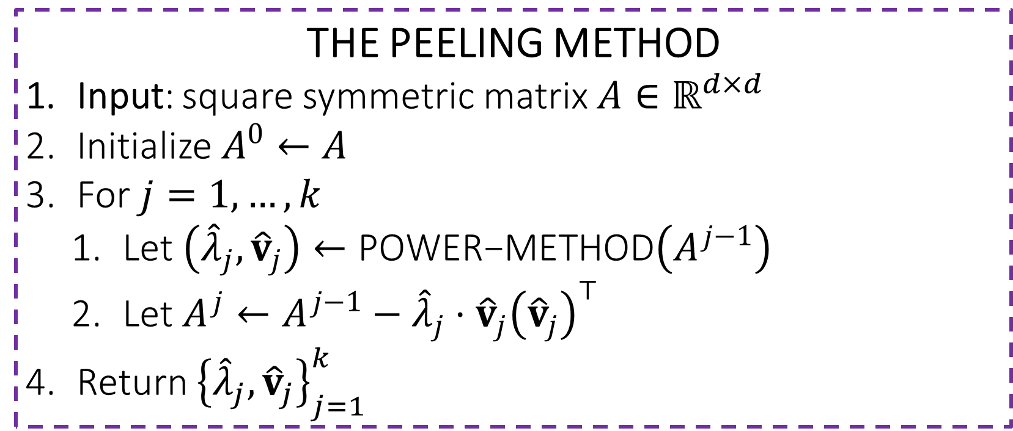

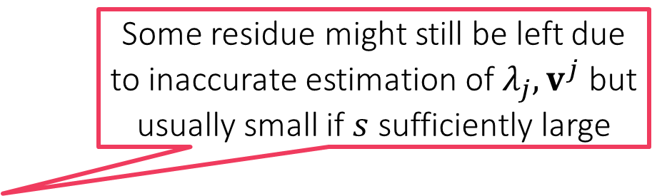
The Peeling Method
THE PEELING METHOD
Input: square symmetric matrix $A∈ℝ^{d×d}$
Initialize $A^{0}←A$
For $j=1,…,k$
Let $\left({\hat{λ}}_{j},{\hat{v}}_{j}\right)←\text{POWER}\text{−}\text{METHOD}\left(A^{j−1}\right)$
Let $A^{j}←A^{j−1}−{\hat{λ}}_{j}⋅{\hat{v}}_{j}{\left({\hat{v}}_{j}\right)}^{⊤}$
Return ${\left\{{\hat{λ}}_{j},{\hat{v}}_{j}\right\}}_{j=1}^{k}$
Takes overall $𝒪\left(kd^{2}s\right)$ time to return the top $k$ leading eigenpairs of $A$
The “peeling” step
After leading eigenpair is peeled off, the eigenpair with the second largest eigenvalue becomes the new leading pair and Power Method can now recover this
Some residue might still be left due to inaccurate estimation of $λ_{j},v^{j}$ but usually small if $s$ sufficiently large
$$A=λ_{1}{\text{v}}^{1}{\left({\text{v}}^{1}\right)}^{⊤}+λ_{2}{\text{v}}^{2}{\left({\text{v}}^{2}\right)}^{⊤}+λ_{3}{\text{v}}^{3}{\left({\text{v}}^{3}\right)}^{⊤}+λ_{4}{\text{v}}^{4}{\left({\text{v}}^{4}\right)}^{⊤}+…$$

Slide 7

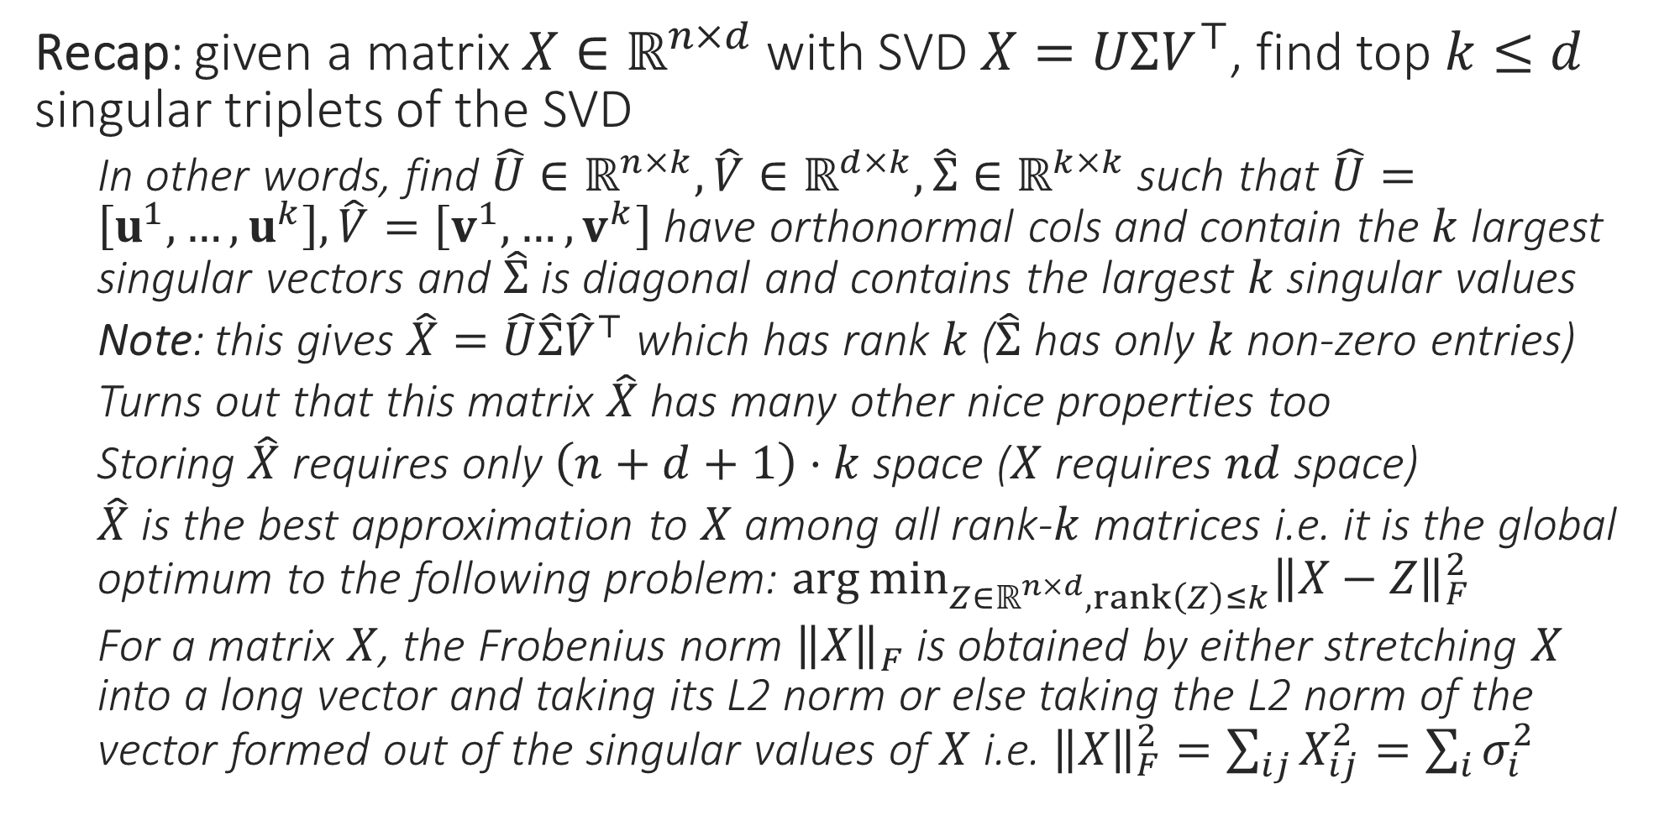
PCA – the inside story
Recap: given a matrix $X∈ℝ^{n×d}$ with SVD $X=UΣV^{⊤}$, find top $k≤d$ singular triplets of the SVD
In other words, find $\hat{U}∈ℝ^{n×k},\hat{V}∈ℝ^{d×k},\hat{Σ}∈ℝ^{k×k}$ such that $\hat{U}=\left[u^{1},…,u^{k}\right],\hat{V}=\left[v^{1},…,v^{k}\right]$ have orthonormal cols and contain the $k$ largest singular vectors and $\hat{Σ}$ is diagonal and contains the largest $k$ singular values
Note: this gives $\hat{X}=\hat{U}\hat{Σ}{\hat{V}}^{⊤}$ which has rank $k$ ($\hat{Σ}$ has only $k$ non-zero entries)
Turns out that this matrix $\hat{X}$ has many other nice properties too
Storing $\hat{X}$ requires only $\left(n+d+1\right)⋅k$ space ($X$ requires $nd$ space)
$\hat{X}$ is the best approximation to $X$ among all rank-$k$ matrices i.e. it is the global optimum to the following problem: $\arg{\min_{Z∈ℝ^{n×d},rank\left(Z\right)≤k}{{\left\|X−Z\right\|}_{F}^{2}}}$
For a matrix $X$, the Frobenius norm ${\left\|X\right\|}_{F}$ is obtained by either stretching $X$ into a long vector and taking its L2 norm or else taking the L2 norm of the vector formed out of the singular values of $X$ i.e. ${\left\|X\right\|}_{F}^{2}=\sum_{ij}{X_{ij}^{2}}=\sum_{i}{σ_{i}^{2}}$
Rows of $\hat{U},\hat{V}$ not necessarily orthonormal

Slide 8
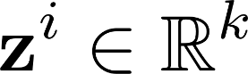
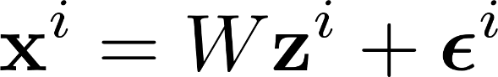
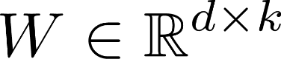
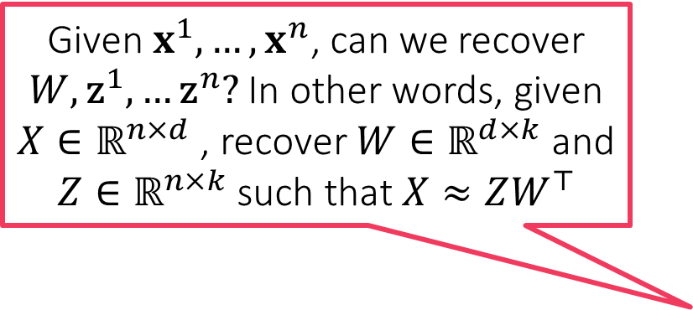
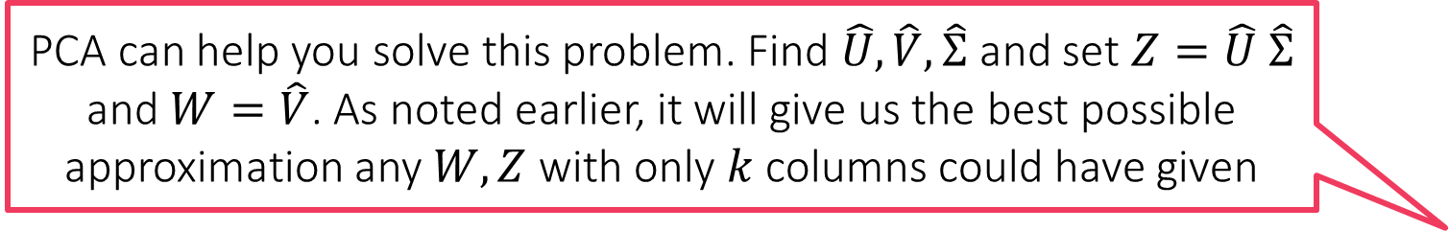
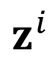
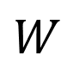
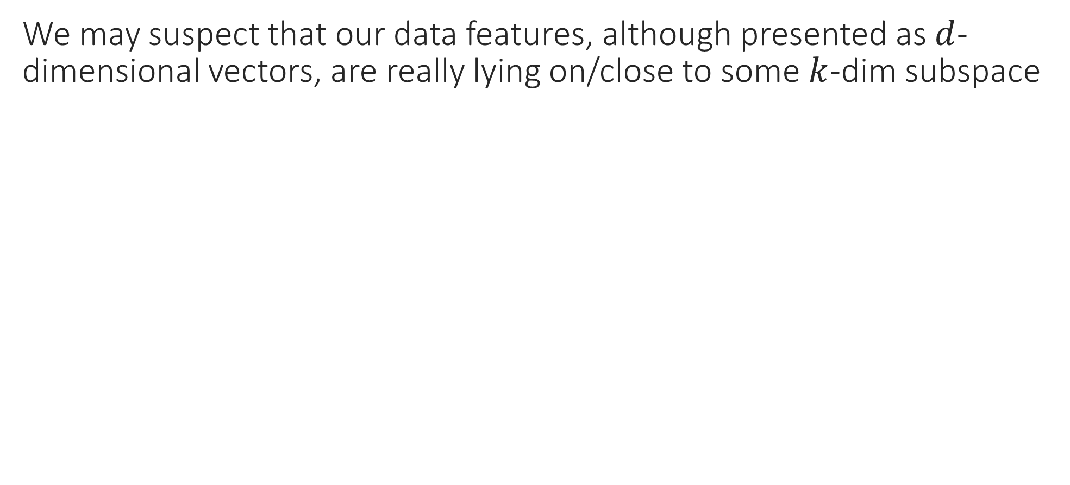
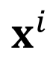
Low dimensional Modelling
PCA can help you solve this problem. Find $\hat{U},\hat{V},\hat{Σ}$ and set $Z=\hat{U} \hat{Σ}$ and $W=\hat{V}$. As noted earlier, it will give us the best possible approximation any $W,Z$ with only $k$ columns could have given
We may suspect that our data features, although presented as $d$-dimensional vectors, are really lying on/close to some $k$-dim subspace
Given $x^{1},…,x^{n}$, can we recover $W,{\text{z}}^{1},…{\text{z}}^{n}?$ In other words, given $X∈ℝ^{n×d}$ , recover $W∈ℝ^{d×k}$ and $Z∈ℝ^{n×k}$ such that $X≈ZW^{⊤}$
$$x^{i}$$
$$W$$
$$z^{i}$$
=
Dictionary/Factor Loading matrix

Slide 9
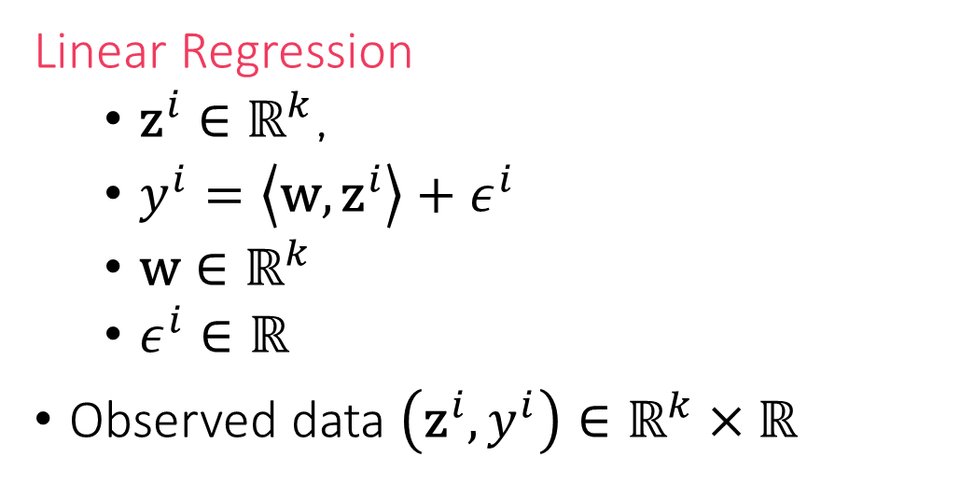
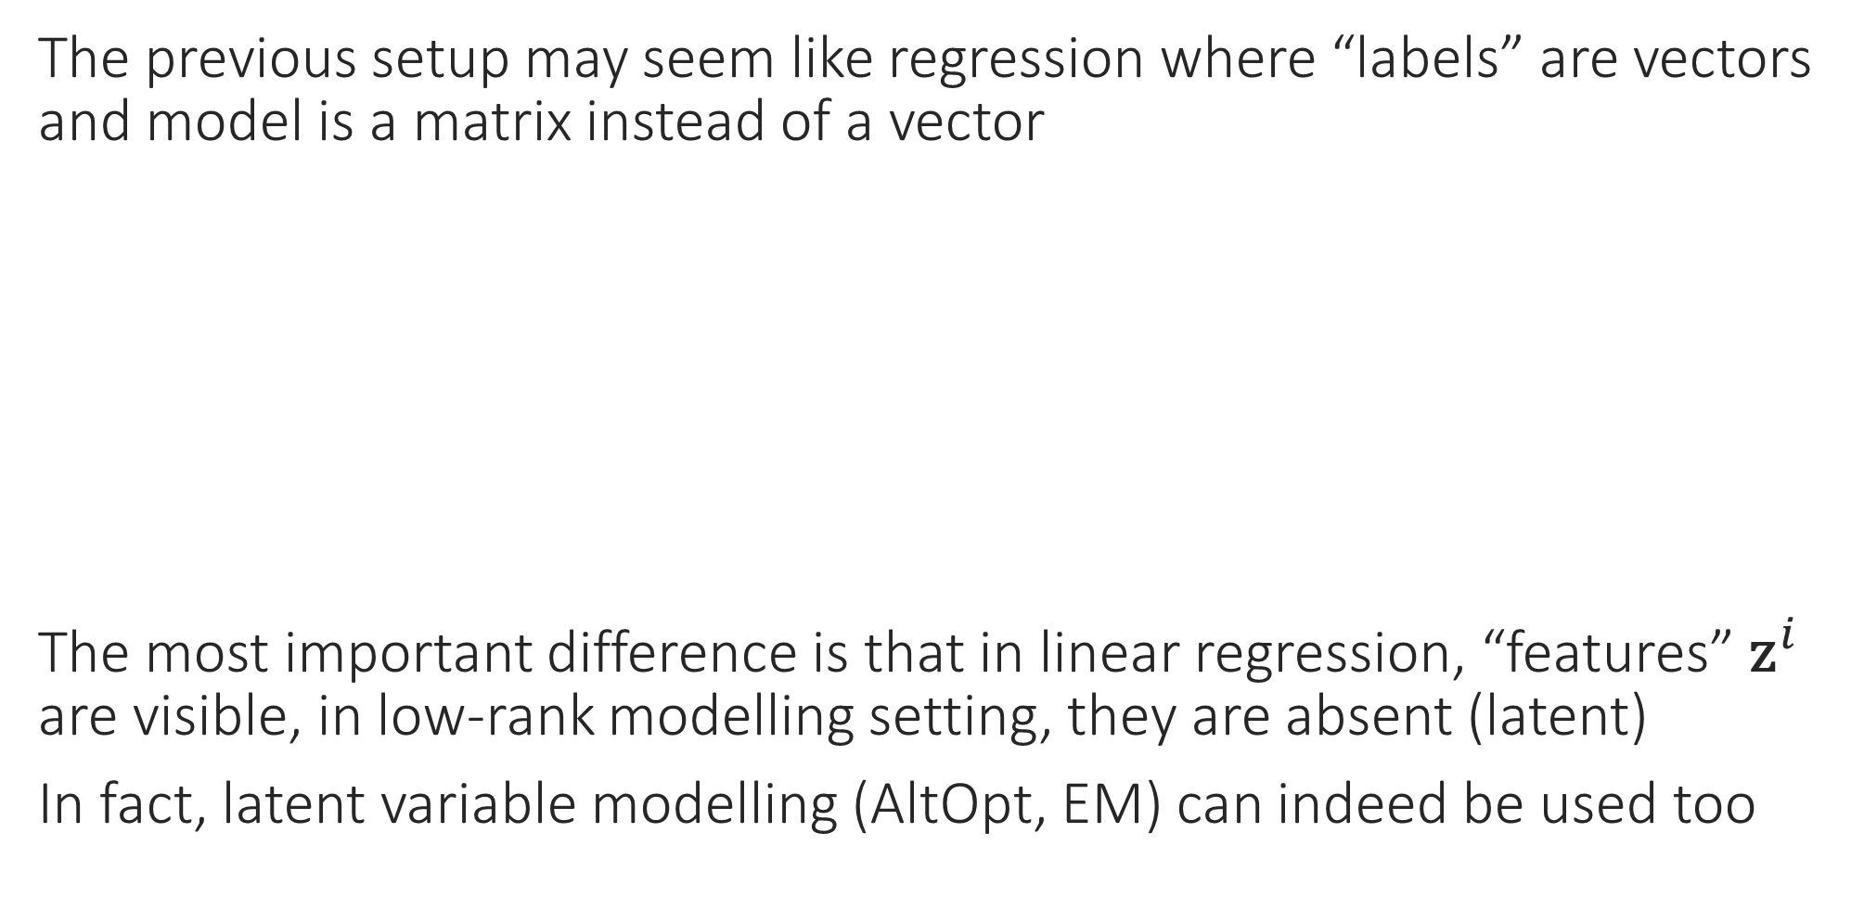
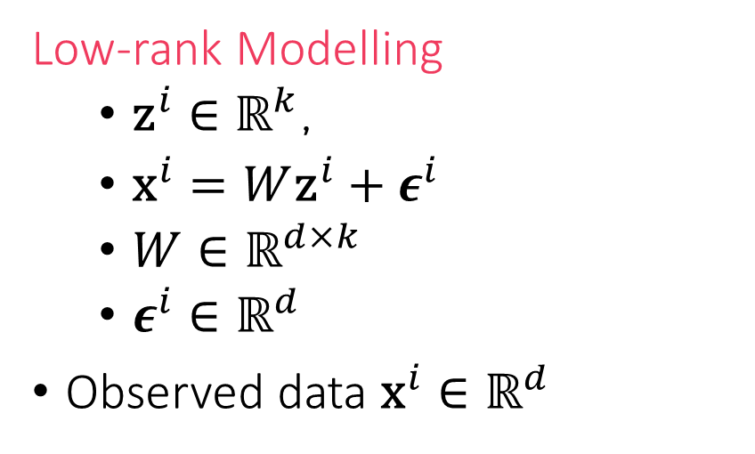
PCA vs Regression
The previous setup may seem like regression where “labels” are vectors and model is a matrix instead of a vector
The most important difference is that in linear regression, “features” ${\text{z}}^{i}$ are visible, in low-rank modelling setting, they are absent (latent)
In fact, latent variable modelling (AltOpt, EM) can indeed be used too
Linear Regression
${\text{z}}^{i}∈ℝ^{k}$,
$y^{i}=\left\langle \text{w},{\text{z}}^{i}\right\rangle +ε^{i}$
$\text{w}∈ℝ^{k}$
$ε^{i}∈ℝ$
Observed data $\left({\text{z}}^{i},y^{i}\right)∈ℝ^{k}×ℝ$
Low-rank Modelling
${\text{z}}^{i}∈ℝ^{k}$,
${\text{x}}^{i}=W{\text{z}}^{i}+ε^{i}$
$W∈ℝ^{d×k}$
$ε^{i}∈ℝ^{d}$
Observed data ${\text{x}}^{i}∈ℝ^{d}$

Slide 10
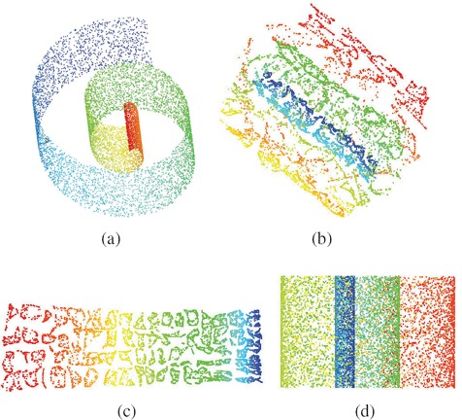
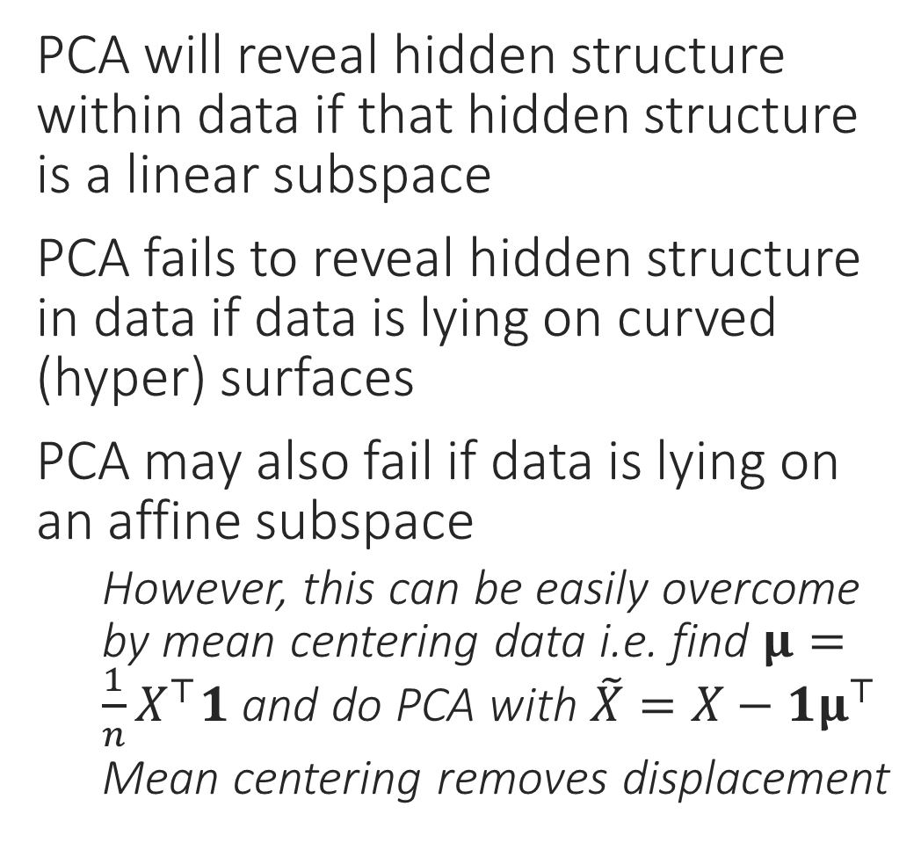
Shortcomings of PCA
What PCA will give us
PCA will reveal hidden structure within data if that hidden structure is a linear subspace
PCA fails to reveal hidden structure in data if data is lying on curved (hyper) surfaces
PCA may also fail if data is lying on an affine subspace
However, this can be easily overcome by mean centering data i.e. find $μ=\frac{1}{n}X^{⊤}1$ and do PCA with $\tilde{X}=X−1μ^{⊤}$
Mean centering removes displacement
“Swiss Roll” data – used to be very popular in ML
What we really want

Slide 11
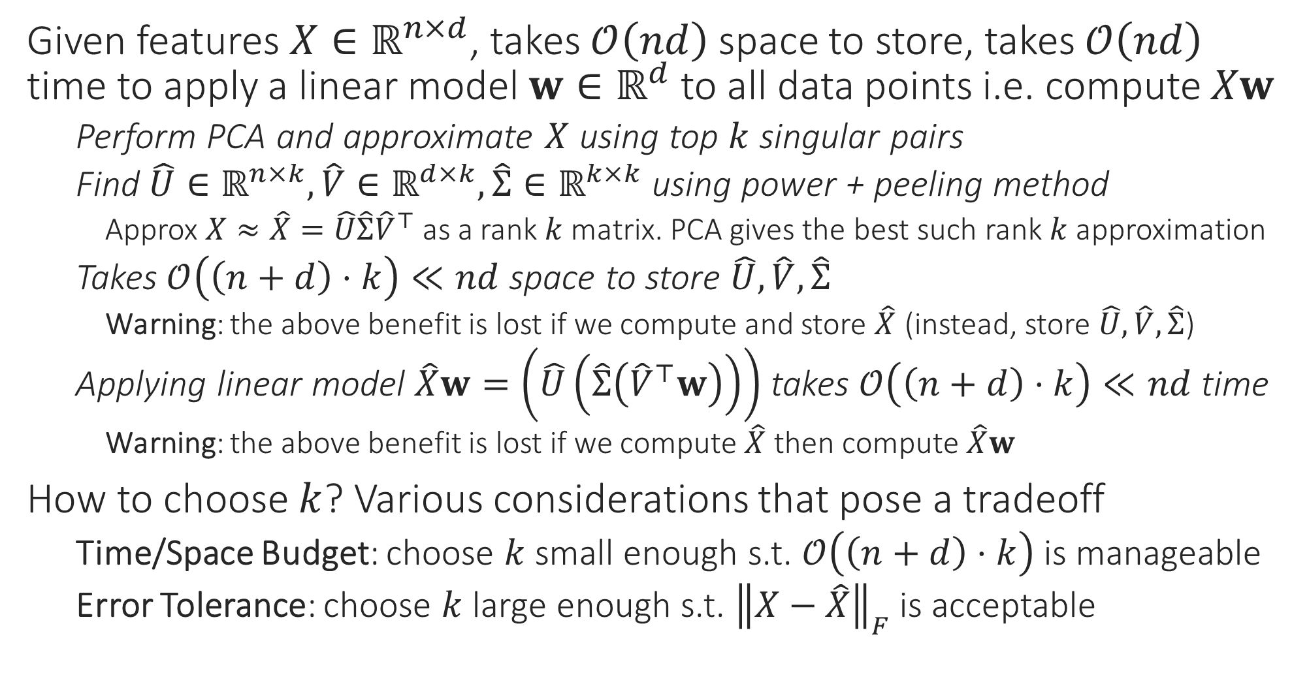

Applications of PCA – Space Savings
Is there are quick way to find whether ${\left\|X−\hat{X}\right\|}_{F}$ is small or not?
Given features $X∈ℝ^{n×d}$, takes $𝒪\left(nd\right)$ space to store, takes $𝒪\left(nd\right)$ time to apply a linear model $w∈ℝ^{d}$ to all data points i.e. compute $Xw$
Perform PCA and approximate $X$ using top $k$ singular pairs
Find $\hat{U}∈ℝ^{n×k},\hat{V}∈ℝ^{d×k},\hat{Σ}∈ℝ^{k×k}$ using power + peeling method
Approx $X≈\hat{X}=\hat{U}\hat{Σ}{\hat{V}}^{⊤}$ as a rank $k$ matrix. PCA gives the best such rank $k$ approximation
Takes $𝒪\left(\left(n+d\right)⋅k\right)≪nd$ space to store $\hat{U},\hat{V},\hat{Σ}$
Warning: the above benefit is lost if we compute and store $\hat{X}$ (instead, store $\hat{U},\hat{V},\hat{Σ}$)
Applying linear model $\hat{X}w=\left(\hat{U}\left(\hat{Σ}\left({\hat{V}}^{⊤}w\right)\right)\right)$ takes $𝒪\left(\left(n+d\right)⋅k\right)≪nd$ time
Warning: the above benefit is lost if we compute $\hat{X}$ then compute $\hat{X}w$
How to choose $k$? Various considerations that pose a tradeoff
Time/Space Budget: choose $k$ small enough s.t. $𝒪\left(\left(n+d\right)⋅k\right)$ is manageable
Error Tolerance: choose $k$ large enough s.t. ${\left\|X−\hat{X}\right\|}_{F}$ is acceptable

Slide 12
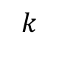
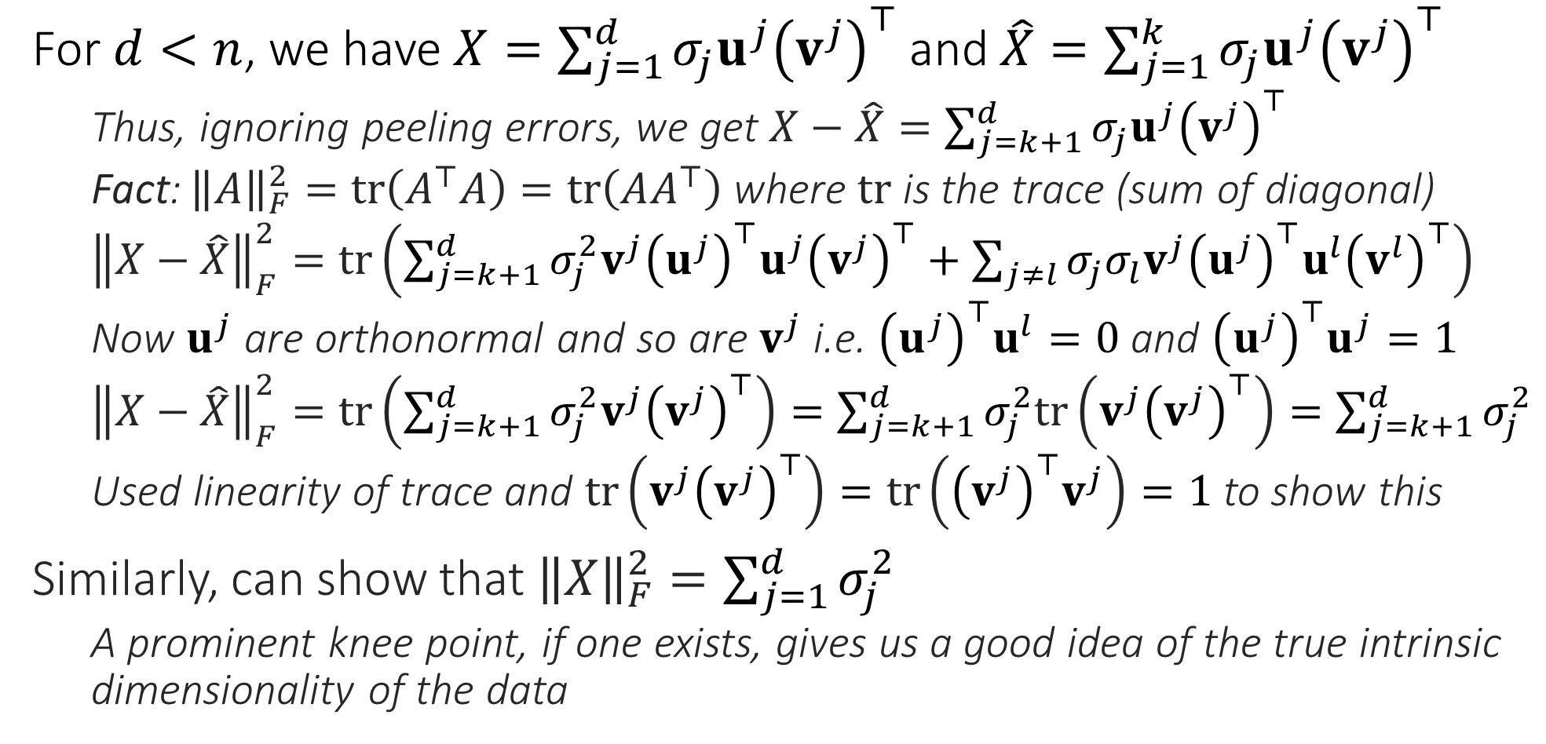
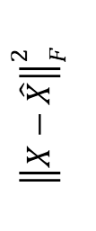

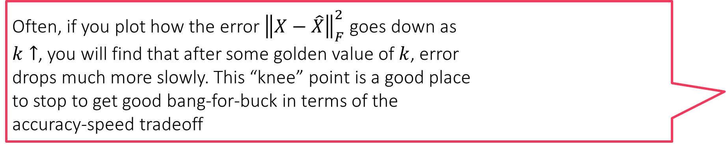
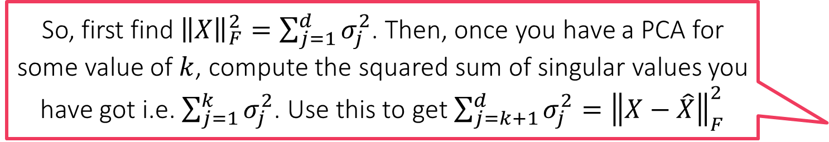
Finding the right value of $k$
So, first find ${\left\|X\right\|}_{F}^{2}=\sum_{j=1}^{d}{σ_{j}^{2}}$. Then, once you have a PCA for some value of $k$, compute the squared sum of singular values you have got i.e. $\sum_{j=1}^{k}{σ_{j}^{2}}$. Use this to get $\sum_{j=k+1}^{d}{σ_{j}^{2}}={\left\|X−\hat{X}\right\|}_{F}^{2}$
For $d<n$, we have $X=\sum_{j=1}^{d}{σ_{j}u^{j}{\left(v^{j}\right)}^{⊤}}$ and $\hat{X}=\sum_{j=1}^{k}{σ_{j}u^{j}{\left(v^{j}\right)}^{⊤}}$
Thus, ignoring peeling errors, we get $X−\hat{X}=\sum_{j=k+1}^{d}{σ_{j}u^{j}{\left(v^{j}\right)}^{⊤}}$
Fact: ${\left\|A\right\|}_{F}^{2}=tr\left(A^{⊤}A\right)=tr\left(AA^{⊤}\right)$ where $tr$ is the trace (sum of diagonal)
${\left\|X−\hat{X}\right\|}_{F}^{2}=tr\left(\sum_{j=k+1}^{d}{σ_{j}^{2}v^{j}{\left(u^{j}\right)}^{⊤}u^{j}{\left(v^{j}\right)}^{⊤}}+\sum_{j≠l}{σ_{j}σ_{l}v^{j}{\left(u^{j}\right)}^{⊤}u^{l}{\left(v^{l}\right)}^{⊤}}\right)$
Now $u^{j}$ are orthonormal and so are $v^{j}$ i.e. ${\left(u^{j}\right)}^{⊤}u^{l}=0$ and ${\left(u^{j}\right)}^{⊤}u^{j}=1$
${\left\|X−\hat{X}\right\|}_{F}^{2}=tr\left(\sum_{j=k+1}^{d}{σ_{j}^{2}v^{j}{\left(v^{j}\right)}^{⊤}}\right)=\sum_{j=k+1}^{d}{σ_{j}^{2}tr\left(v^{j}{\left(v^{j}\right)}^{⊤}\right)}=\sum_{j=k+1}^{d}{σ_{j}^{2}}$
Used linearity of trace and $tr\left(v^{j}{\left(v^{j}\right)}^{⊤}\right)=tr\left({{\left(v^{j}\right)}^{⊤}v}^{j}\right)=1$ to show this
Similarly, can show that ${\left\|X\right\|}_{F}^{2}=\sum_{j=1}^{d}{σ_{j}^{2}}$
A prominent knee point, if one exists, gives us a good idea of the true intrinsic dimensionality of the data
Often, if you plot how the error ${\left\|X−\hat{X}\right\|}_{F}^{2}$ goes down as $k↑$, you will find that after some golden value of $k$, error drops much more slowly. This “knee” point is a good place to stop to get good bang-for-buck in terms of the accuracy-speed tradeoff
“knee” point
$${\left\|X−\hat{X}\right\|}_{F}^{2}$$
$$k$$

Slide 13
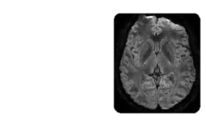
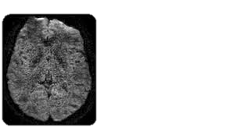
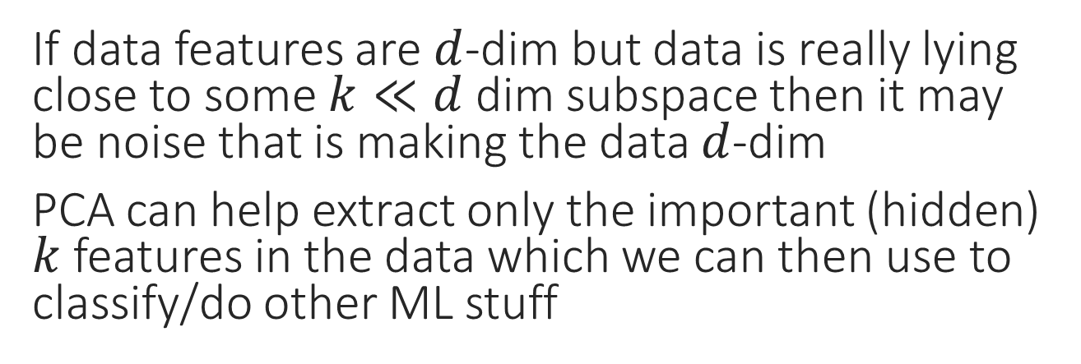
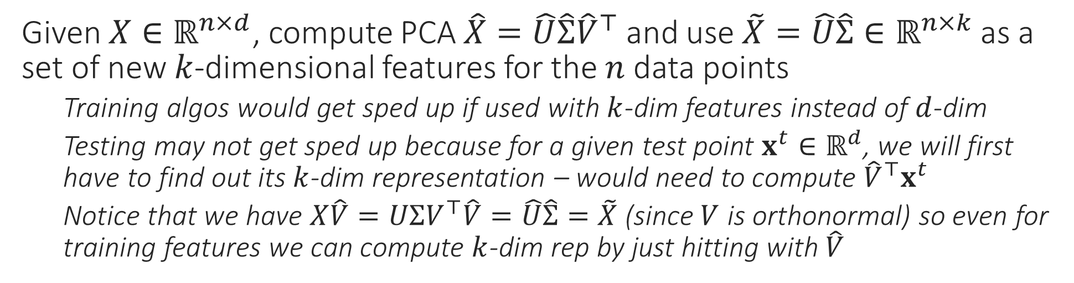
Applications of PCA – Noise Removal
Treat images as matrix and “smoothen” the image by taking a low-rank approximation
If data features are $d$-dim but data is really lying close to some $k≪d$ dim subspace then it may be noise that is making the data $d$-dim
PCA can help extract only the important (hidden) $k$ features in the data which we can then use to classify/do other ML stuff
Given $X∈ℝ^{n×d}$, compute PCA $\hat{X}=\hat{U}\hat{Σ}{\hat{V}}^{⊤}$ and use $\tilde{X}=\hat{U}\hat{Σ}∈ℝ^{n×k}$ as a set of new $k$-dimensional features for the $n$ data points
Training algos would get sped up if used with $k$-dim features instead of $d$-dim
Testing may not get sped up because for a given test point $x^{t}∈ℝ^{d}$, we will first have to find out its $k$-dim representation – would need to compute ${\hat{V}}^{⊤}x^{t}$
Notice that we have $X\hat{V}=UΣV^{⊤}\hat{V}=\hat{U}\hat{Σ}=\tilde{X}$ (since $V$ is orthonormal) so even for training features we can compute $k$-dim rep by just hitting with $\hat{V}$

Slide 14


Foreground Background Separation
$$=$$
$$+$$
14

Slide 15
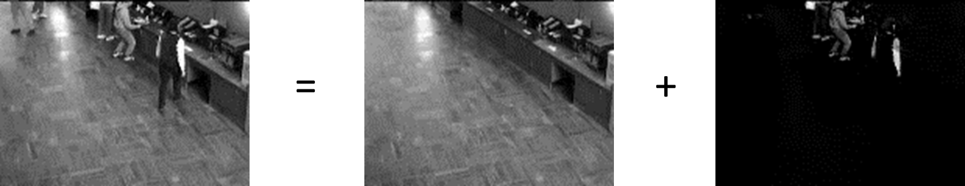
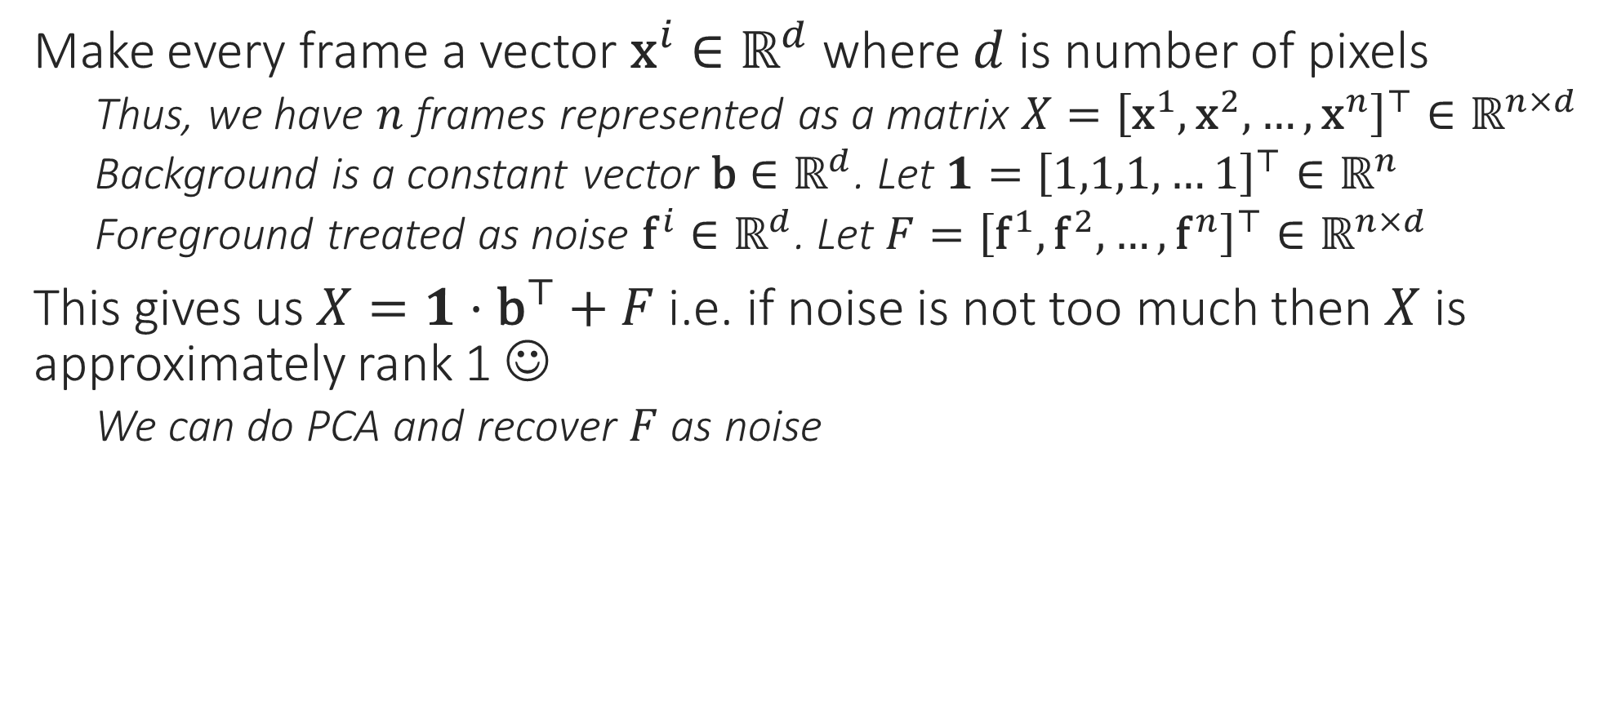
Denoising, Foreground Extraction
Note: here we are treating images as vectors and a group of images (say a video) is treated as a matrix – this is different from the noise removal example where every image was treated as a matrix itself
Make every frame a vector ${\text{x}}^{i}∈ℝ^{d}$ where $d$ is number of pixels
Thus, we have $n$ frames represented as a matrix $X={\left[{\text{x}}^{1},{\text{x}}^{2},…,{\text{x}}^{n}\right]}^{⊤}∈ℝ^{n×d}$
Background is a constant vector $\text{b}∈ℝ^{d}$. Let $1={\left[1,1,1,…1\right]}^{⊤}∈ℝ^{n}$
Foreground treated as noise ${\text{f}}^{i}∈ℝ^{d}$. Let $F={\left[{\text{f}}^{1},{\text{f}}^{2},…,{\text{f}}^{n}\right]}^{⊤}∈ℝ^{n×d}$
This gives us $X=1⋅{\text{b}}^{⊤}+F$ i.e. if noise is not too much then $X$ is approximately rank 1 ☺
We can do PCA and recover $F$ as noise

Slide 16
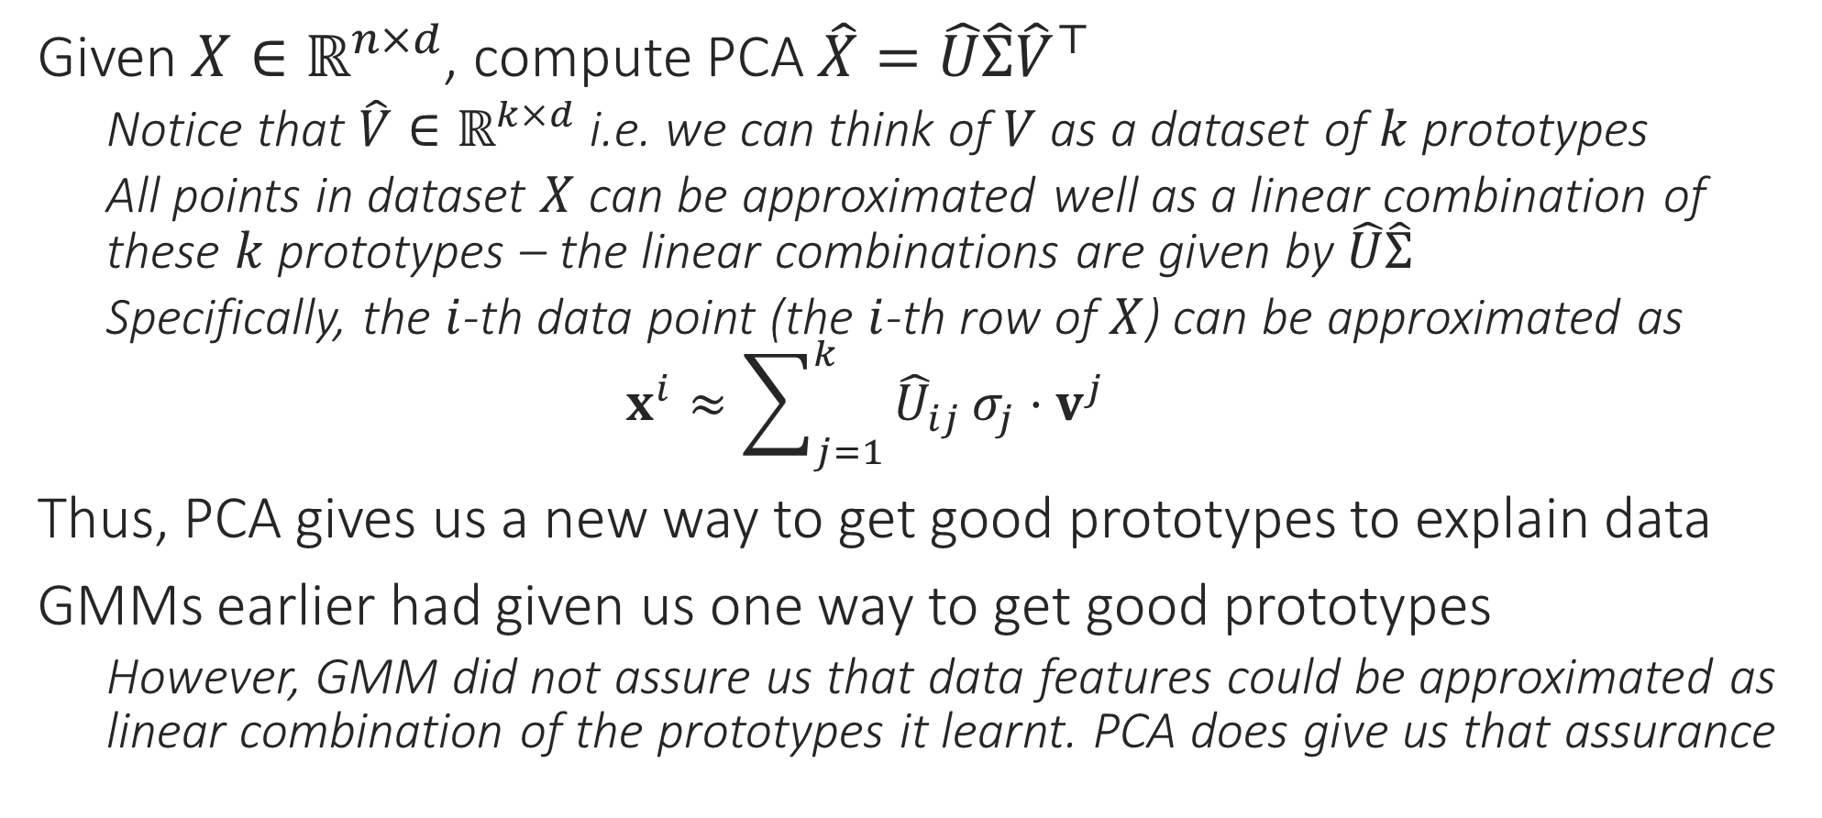
Applications of PCA – Learning Prototypes
Given $X∈ℝ^{n×d}$, compute PCA $\hat{X}=\hat{U}\hat{Σ}{\hat{V}}^{⊤}$
Notice that $\hat{V}∈ℝ^{k×d}$ i.e. we can think of $V$ as a dataset of $k$ prototypes
All points in dataset $X$ can be approximated well as a linear combination of these $k$ prototypes – the linear combinations are given by $\hat{U}\hat{Σ}$
Specifically, the $i$-th data point (the $i$-th row of $X$) can be approximated as $x^{i}≈\sum_{j=1}^{k}{{\hat{U}}_{ij}}σ_{j}⋅v^{j}$
Thus, PCA gives us a new way to get good prototypes to explain data
GMMs earlier had given us one way to get good prototypes
However, GMM did not assure us that data features could be approximated as linear combination of the prototypes it learnt. PCA does give us that assurance

Slide 17
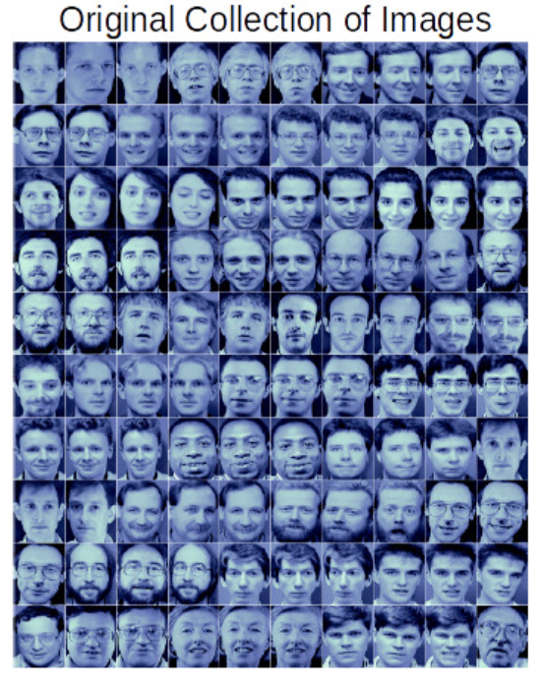
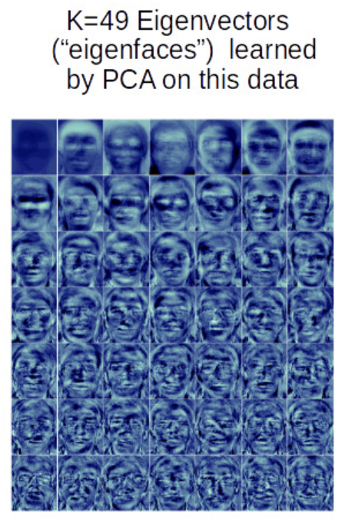
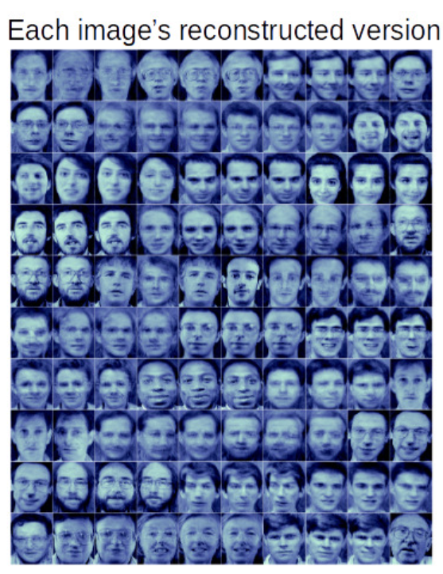
Eigenfaces [Sirovich and Kirby, Turk and Pentland]
Note: here again, we are treating images as vectors and a group of images is treated as a matrix
An iconic application of PCA – given face images, the prototypes given by the leading few right singular vectors are called “eigenfaces”
Images are treated as vectors for this (and many other) application

Slide 18

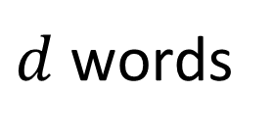

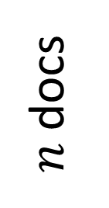
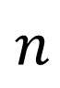








Latent Semantic Analysis (LSA/LSI)
Each topic here is represented by a prototypical document for that topic. All documents are linear representations of the topics. The amount of weight a document places on a certain topic in its representation tells us a lot about what is that document talking about e.g. if $\left|U_{ij}\right|≫1$ then the $j$-th topic is really core to the $i$-th document
Used to be a very popular course project topic ☺
Given $n$ documents, each as bag-of-words representation with dictionary size $d$ as very large $d≈{10}^{6}$, discover $k≪d$ “topics” about which the documents are talking
Topics could be sports, education, politics, science, entertainment
Word of caution: PCA itself will not tell you whether blah prototype is about sports or bleh prototype is about politics. You have to take a look at the prototype vector, also look at documents that place lots of weight on that prototype and make these deductions separately
$d$ words
$k$ topics
$d$ words
$k$ topics
$$≈$$
$n$ docs
$$n$$
$$X$$
$$\hat{U}\hat{Σ}$$
$$\hat{V}$$

Slide 19






Recommendation Systems
Word of caution: A recommendation system where users have features, is called content-based filtering. However, in the setting in this slide, users have no features. A drawback of collaborative filtering is that it gets more difficult to add new users to the system
A popular technique is RecSys is Collaborative Filtering
Have data for $n$ users and their interactions with $d$ items
For these $n$ users, predict other items that they would also like
Done by discovering $k$ “user types” and representing each user as a combination of these user types
$d$ items
$k$ types
$d$ items
$k$ types
$$≈$$
$n$ users
$$n$$

Slide 20

The Many Faces of PCA
Has been “discovered” several times [Pearson, 1901; Hotelling, 1930]
Gives us best possible (in terms of Frob. norm error) low-rank approx of our data
Can be thought of as giving low-dim reps of our feature vectors so that pairwise L2 distances among them is preserved – see multidimensional scaling (MDS)
Also, gives us new basis with smaller dim ($\hat{V}$ is orthonormal) s.t. in that basis, data can be reconstructed with little error
Can also be thought of as giving us the directions along which the data has maximum variance
This line captures most of the information in the data Why not get rid of the other information? Save space, reduce noise!

Slide 21


PCA Minimizes Reconstruction Error
We can show that for $k>1$ as well, PCA offers the best reconstruction error. In that case, instead of optimizing over a unit vector $w∈ℝ^{d}$, we would have to optimize over an orthonormal matrix $V∈ℝ^{d×k}$
Already seen that for any matrix $X∈ℝ^{n×d}$, its best rank $k$ approx. is obtained by $\hat{X}=\hat{U}\hat{Σ}{\hat{V}}^{⊤}$ by taking leading $k$ singular triplets
Proof for $k=1$: want best rank $1$ approx. for $X$ i.e. want to fit all data points on a 1D subspace i.e. find a unit vector $w∈ℝ^{d}$ s.t. data is best represented along subspace spanned by $w$ than any other vector $v$
Claim: any vector $x∈ℝ^{d}$ is best represented in $span\left(w\right)$ as $w^{⊤}x⋅w$
Proof: we want $\underset{t∈ℝ}{arg min}{{\left\|x−t⋅w\right\|}_{2}^{2}}$. Apply first order optimality now
Thus, reconstruction error for entire dataset is $\sum_{i=1}^{n}{{\left\|x^{i}−w^{⊤}x^{i}⋅w\right\|}_{2}^{2}}$
${argmin}_{{\left\|w\right\|}_{2}=1}{\sum_{i=1}^{n}{{\left\|x^{i}−{ww}^{⊤}x^{i}\right\|}_{2}^{2}}}={argmin}_{{\left\|w\right\|}_{2}=1}{\sum_{i=1}^{n}{−{\left(w^{⊤}x^{i}\right)}^{2}}}$
${argmax}_{{\left\|w\right\|}_{2}=1}{w^{⊤}\left(\sum_{i=1}^{n}{{x^{i}\left(x^{i}\right)}^{⊤}}\right)w}={argmax}_{{\left\|w\right\|}_{2}=1}{w^{⊤}\left(X^{⊤}X\right)w}$
This matches exactly the definition of the leading eigenvector of $X^{⊤}X$

Slide 22



PCA Preserves Maximum Data Variance
Data may take similar values along one direction, varied values along another
Directional variance: given a unit vector $u∈ℝ^{d}$, directional var. along $u$ is defined as variance of the r.v. $z=u^{⊤}x$ where we choose each data point $x^{i}$ w.p. $1/n$
Assume data is centered i.e. $\sum_{i=1}^{n}{x^{i}}=0$
Thus, $𝔼z=0$ i.e. $𝕍z=𝔼\left[z^{2}\right]$
Projecting onto this line throws away a lot of information about the data ☹
Directions with more directional variance preserve more info
PCA does give us orthonormal directions with largest directional variance
$𝔼\left[z^{2}\right]=\frac{1}{n}\sum_{i=1}^{n}{{\left(u^{⊤}x^{i}\right)}^{2}}=\frac{1}{n}u^{⊤}\left(X^{⊤}X\right)u$
Thus, finding the direction offering the maximum directional variance is the same as finding the leading right singular vector
We can show that for $k>1$ as well, PCA offers a set of orthonormal directions such that the total directional variance captured along those directions is the maximum.

Slide 23



Probabilistic PCA
The real data was actually sampled from a $k$-dim standard Gaussian, but got linearly mapped to a $d$-dim space and some noise got added
Given $x^{1},…,x^{n}$, can we recover $W,{\text{z}}^{1},…{\text{z}}^{n}?$ In other words, given $X∈ℝ^{n×d}$ , recover $W∈ℝ^{d×k}$ and $Z∈ℝ^{n×k}$ such that $X≈ZW^{⊤}$
$$x^{i}$$
$$W$$
$$z^{i}$$
=
Dictionary/Factor Loading matrix

Slide 24

Probabilistic PCA [Tipping and Bishop, 1999]
It is very unusual for latent variables to simply integrate out like this leaving behind a nice Gaussian density. We got very lucky here ☺. Usually latent variables mean AltOpt/EM
Given samples $X={\left[x^{1},…,x^{n}\right]}^{⊤}∈ℝ^{n×d}$, we wish to recover $W,σ,z^{i}$
Note: this is a generative problem, i.e. deals with generation of feature vectors
As discussed before, the original data $z^{i}∼𝒩\left(0,I_{k}\right)$ are “latent” – not seen
Also clear from the noise model that $ℙ\left[x^{i} | z^{i},σ,W\right]=𝒩\left(x^{i};Wz^{i},σ^{2}⋅I_{d}\right)$
More flexible models possible e.g. Factor Analysis – will see later
Will first see how to recover $W,σ$ and then head into recovering $z^{i}$
Some mildly painful integrals later we can get
$ℙ\left[x^{i} | σ,W\right]=\int_{z∈ℝ^{k}}{ℙ\left[x^{i} | z^{i},σ,W\right]⋅ℙ\left[z^{i}\right] dz}=𝒩\left(0,σ^{2}⋅I+WW^{⊤}\right)$
The above also assumes $ℙ\left[z^{i} | σ,W\right]=ℙ\left[z^{i}\right]=𝒩\left(z^{i};0,I_{k}\right)$
Thus, to simplify life, we can pretend for a moment that our samples $X$ were really generated from $𝒩\left(0,σ^{2}⋅I+WW^{⊤}\right)$ and there are no $z^{i}$ in the picture.
Can we now do MLE to find $σ,W$?

Slide 25



An MLE For $W,σ$ in PPCA
If we decide to set $σ=0$ (and not estimate it either) then we get ${\hat{W}}_{MLE}=\hat{Q}\sqrt{\hat{Λ}}$ which, apart from the scaling with the eigenvalues, is just $\hat{V}$ in PCA! Thus, PCA $≡$ PPCA (apart from a scaling factor) under the noiseless assumption ☺
We get $n$ samples $X$ from $𝒩\left(0,σ^{2}⋅I+WW^{⊤}\right)$. The log-likelihood is
$\log{ℙ\left[X | σ,W\right]}=\frac{n}{2}\left(d\log{2π}+\log\left|C\right|+tr\left(C^{−1}S\right)\right)$
where $C=WW^{⊤}+σ^{2}⋅I_{d}$ and $S=\frac{1}{n}⋅X^{⊤}X$
Note: $C$ is always invertible because of $σ^{2}⋅I_{d}$ (imp. since $\left|WW^{⊤}\right|=0$ ☹)
Can apply first order optimality to get MLE (painful derivatives though)
Thankfully, end result is very familiar. Let $S=QΛQ^{⊤}$ be eigendecomposition of $S$ where $Q=\left[q^{1},…,q^{d}\right]$ and $Λ=diag\left(λ_{1},…,λ_{d}\right)$ with $λ_{1}≥λ_{2}≥…$
An ED always exists for $S$ since it is square symmetric
${\hat{W}}_{MLE}=\hat{Q}\sqrt{\hat{Λ}−{\hat{σ}}_{MLE}^{2}⋅I_{k}}$ where $\hat{Q}=\left[q^{1},…,q^{k}\right],\hat{Λ}=diag\left(λ_{1},…,λ_{k}\right)$
${\hat{σ}}_{MLE}=\frac{1}{d−k}\sum_{j=k+1}^{d}{λ_{j}}$

Slide 26

PPCA Variants
We can tweak several moving parts in the PPCA generative process
Can instead assume that $z^{i}∼𝒩\left(μ_{z},Σ_{z}\right)$ and estimate $μ_{z},∈ℝ^{k},Σ_{z}∈ℝ^{k×k}$
Can assume non-spherical noise $ε^{i}∼𝒩\left(0,Σ_{ε}\right)$ and estimate $Σ_{ε}∈ℝ^{d×d}$
A technique called Factor Analysis actually uses non-spherical noise model
Since PPCA is a generative model, it can model missing data too
Suppose we have already found out ${\hat{σ}}_{MLE},{\hat{W}}_{MLE}$ using clean training data
If test data has missing features $x^{t}=\left[x_{o}^{t},x_{m}^{t}\right]∈ℝ^{d}$, use fact that marginals of Gaussians are Gaussian. Since we know $x^{t}∼𝒩\left(0,{\hat{σ}}^{2}⋅I+\hat{W}{\hat{W}}^{⊤}\right)$, we can see $ℙ\left[x_{o}^{t}\right]=𝒩\left(0,{\hat{σ}}^{2}⋅I_{o}+{\hat{W}}_{o}{{\hat{W}}_{o}}^{⊤}\right)$ (${\hat{W}}_{o}∈ℝ^{\left|o\right|×k}$ has only observed rows)
Missing test data is easier to handle, missing training data more challenging
Need to apply the above trick when defining the likelihood of training data points
Each training data point may have different coordinates missing. If we do not even know when a coordinate has gone missing then this becomes more challenging ☹

Slide 27

Dimensionality Reduction using PPCA
With PCA $X≈\hat{X}=\hat{U}\hat{Σ}{\hat{V}}^{⊤}$ we got low-dim feat. easily $\tilde{X}=\hat{U}\hat{Σ}∈ℝ^{n×k}$
These made sense because these are $k$-dim features which are just a rotation away (using $V$) from features $\hat{X}$ which we know approximate $X$ very well
With PPCA too we can we recover the original low-dim features $z^{i}∈ℝ^{k}$ by treating them as latent variables and applying AltOpt or EM
Need to be careful since these latent variables are (continuous) vectors now!
Earlier, we used a shortcut $ℙ\left[x^{i} | σ,W\right]=𝒩\left(0,σ^{2}⋅I+WW^{⊤}\right)$ to get MLE for $W,σ$. To get hold of $z^{i}$ we need proper AltOpt/EM
$ℙ\left[x^{i} | σ,W\right]=\int_{ℝ^{k}}{ℙ\left[x^{i},z^{i} | σ,W\right]} dz^{i}$
AltOpt will approximate integral using a single term (a single value for $z^{i}$)
EM will lower bound the integral using another (easier to compute) integral
Need to replace “sum” over possible values of $z^{i}$ with “integral” since $z^{i}$ cont.

Slide 28



PPCA – Alternating Optimization
These derivations are routine but tedious. You can check [BIS] Chapter 12 for details. Warning: equation 12.42 in that book has an error. The correct expression is given in this slide
We wish to get $\arg{\max_{W,σ}{\sum_{i=1}^{n}{\ln\left(\int_{ℝ^{k}}{ℙ\left[x^{i},z^{i} | σ,W\right]} dz^{i}\right)}}}$
Same old pesky sum-log-sum (actually sum-log-integral) form – difficult ☹
Approximate integral by its most dominant term $\int_{ℝ^{k}}{ℙ\left[x^{i},z^{i} | σ,W\right]}{dz}^{i}≈$
$ℙ\left[x^{i},{\tilde{z}}^{i}|σ,W\right]$ with ${\tilde{z}}^{i}=\arg{\max_{z}{ℙ\left[x^{i},z | σ,W\right]}}=\arg{\max_{z}{ℙ\left[z |{ x}^{i},σ,W\right]}}$
Approx. integral by a single term may not be bad if the dist. $ℙ\left[z |{ x}^{i},σ,W\right]$ has small variance – advantage of being cheaper than EM in computation time
Thus, we wish to solve $\arg{\max_{W,σ,z^{i}}{\sum_{i=1}^{n}{\ln{ℙ\left[x^{i},z^{i} | σ,W\right]}}}}$
$ℙ\left[z^{i} | x^{i},σ,W\right]=𝒩\left(z^{i};μ_{z}^{i},Σ_{z}\right)$ where $μ_{z}^{i}={\left(W^{⊤}W+σ^{2}⋅I_{k}\right)}^{−1}W^{⊤}x^{i}∈ℝ^{k}$ and $Σ_{z}=σ^{2}⋅{\left(W^{⊤}W+σ^{2}⋅I_{k}\right)}^{−1}∈ℝ^{k×k}$
Since for Gaussians, mode is mean, we have $\arg{\max_{z}{ℙ\left[z |{ x}^{i},σ,W\right]}}=μ_{z}^{i}$
This gives us one of the alternating updates, lets derive the other
Because this the mean of $z^{i}$ conditioned on $x^{i}$. It is the marginal (unconditional) mean of $z^{i}$ that is $0$. Suppose we know that $x^{i}=Wz^{i}+ε^{i}$ is a vector far off from the origin. The it is likely that $Wz^{i}≠0$ as well which immediately tells that $z^{i}≠0$
We know that $z^{i}∼𝒩\left(z^{i};0,I_{k}\right)$. Then how come $μ_{z}^{i}≠0$?
Because of some beautiful coincidences: 1) it turns out that $ℙ\left[z^{i} | x^{i},σ,W\right]$ is a Gaussian, 2) for Gaussians, mean is mode which means that 3) $μ_{z}^{i}$ is the MLE solution to the problem $x^{i}=Wz^{i}+ε^{i}$ which is indeed a vector least squares regression problem
Why does the expression $μ_{z}^{i}={\left(W^{⊤}W+σ^{2}⋅I_{k}\right)}^{−1}W^{⊤}x^{i}$ look like least squares?

Slide 29

PPCA – Alternating Optimization
$\sum_{i=1}^{n}{\ln{ℙ\left[x^{i},z^{i} | σ,W\right]}}=\frac{1}{2σ^{2}}{\sum_{i=1}^{n}{\left\|x^{i}−Wz^{i}\right\|}}_{2}^{2}+dn\ln{σ}$
Thus, if $z^{i}$ are fixed, we can obtain $W,σ$ using first order optimality
$\arg{\min_{W}{{\sum_{i=1}^{n}{\left\|x^{i}−Wz^{i}\right\|}}_{2}^{2}}}=\arg{\min_{W}{tr\left(W^{⊤}WA\right)−2}}tr\left(W^{⊤}B\right)$ where $A=\sum_{i=1}^{n}{z^{i}{\left(z^{i}\right)}^{⊤}}$ and $B=\sum_{i=1}^{n}{x^{i}{\left(z^{i}\right)}^{⊤}}$
See [BIS] Chap 12 for detailed derivations - check that dimensionalities match
Apply first order optimality to get ${\hat{W}}_{MLE}=BA^{−1}$
Once $W$ is known, $σ$ can also be found using first order optimality
${\hat{σ}}_{MLE}=\sqrt{\frac{1}{dn}{\sum_{i=1}^{n}{\left\|x^{i}−{\hat{W}}_{MLE}z^{i}\right\|}}_{2}^{2}}$

Slide 30




PPCA – Alternating Optimization
Total of $𝒪\left(k^{2}\left(d+n\right)+kdn\right)$ time taken per iteration. In contrast, PCA using power + peeling method takes only $𝒪\left(kdn\right)$ time if we do power updates as $Av=X^{⊤}\left(Xv\right)$ which takes $𝒪\left(dn\right)$ time per power step
ALTERNATING OPTIMIZATION
Initialize $W$
For $t=0, 1, 2,…$
Update $z^{i}$ fixing $W,σ$
Let $z^{i}={\left(W^{⊤}W+{σ^{2}⋅I}_{k}\right)}^{−1}W^{⊤}x^{i}$, for $i∈\left[n\right]$
Update $W,σ$ fixing $z^{i}$
Calculate $A=\sum_{i=1}^{n}{z^{i}{\left(z^{i}\right)}^{⊤}}$ and $B=\sum_{i=1}^{n}{x^{i}{\left(z^{i}\right)}^{⊤}}$
Update $W=BA^{−1}$
Calculate $V={\sum_{i=1}^{n}{\left\|x^{i}−Wz^{i}\right\|}}_{2}^{2}$
Update $σ=\sqrt{V/dn}$
$𝒪\left(k^{3}\right)$ time to calculate the inverse term and $𝒪\left(kdn+k^{2}d\right)$ time to calculate all $z^{i}$ terms afterward
In practice, PCA is usually faster than AltOpt PPCA – no inverses required to solve PCA, just simple mat-vec multiplication steps ☺
$𝒪\left(k^{2}n+k^{3}\right)$ time for $A^{−1}$, $𝒪\left(dkn\right)$ time for $B$ and finally $𝒪\left(k^{2}d\right)$ time for $W$

Slide 31

PPCA – Expectation Maximization
We wish to get $\arg{\max_{W,σ}{\sum_{i=1}^{n}{\ln\left(\int_{ℝ^{k}}{ℙ\left[x^{i},z^{i} | σ,W\right]} dz^{i}\right)}}}$
As before, given a model $\hat{W},\hat{σ}$, let $q\left(z^{i}\right)=ℙ\left[z^{i} | x^{i},\hat{σ},\hat{W}\right]$ and lower bound the integral using Jensen’s inequality (the term $C$ does not depend on $W,σ$)
$\ln\left(\int_{ℝ^{k}}{ℙ\left[x^{i},z^{i} | σ,W\right]} dz^{i}\right)≥\int_{ℝ^{k}}{q\left(z^{i}\right)⋅\ln{ℙ\left[x^{i},z^{i} | σ,W\right]}} dz^{i}+C$
Some simple (but non-trivial) calculations show that the resulting EM algorithm looks very similar to the AltOpt with a few simple changes
Replace $z^{i}$ with $ζ^{i}≜𝔼\left[z^{i}\right]=\int_{ℝ^{k}}{q\left(z^{i}\right)⋅z^{i}} dz^{i}={\left(W^{⊤}W+{σ^{2}⋅I}_{k}\right)}^{−1}W^{⊤}x^{i}$
This is the same as we used in AltOpt since for Gaussian, mode is the same as mean
Replace $z^{i}{\left(z^{i}\right)}^{⊤}$ with $Z^{i}≜𝔼\left[z^{i}{\left(z^{i}\right)}^{⊤}\right]=\int_{ℝ^{k}}{q\left(z^{i}\right)⋅z^{i}{\left(z^{i}\right)}^{⊤}} dz^{i}$ $=ζ^{i}{\left(ζ^{i}\right)}^{⊤}+σ^{2}⋅{\left(W^{⊤}W+{σ^{2}⋅I}_{k}\right)}^{−1}$
Rest of the algorithm (can be shown to) remain the same (see [BIS] Chap 12)

Slide 32

PPCA – Expectation Maximization
Time complexity of PPCA using EM roughly same as that of PPCA using AltOpt.
EXPECTATION MAXIMIZATION
Initialize $W$
For $t=0, 1, 2,…$
Update $ζ^{i},Z^{i}$ fixing $W,σ$
Let $ζ^{i}={\left(W^{⊤}W+{σ^{2}⋅I}_{k}\right)}^{−1}W^{⊤}x^{i}$, for $i∈\left[n\right]$
Let $Z^{i}=ζ^{i}{\left(ζ^{i}\right)}^{⊤}+σ^{2}⋅{\left(W^{⊤}W+{σ^{2}⋅I}_{k}\right)}^{−1}$
Update $W,σ$ fixing $ζ^{i},Z^{i}$
Update $W=\left(\sum_{i=1}^{n}{x^{i}{\left(ζ^{i}\right)}^{⊤}}\right){\left(\sum_{i=1}^{n}{Z^{i}}\right)}^{−1}$
Calculate $V={\sum_{i=1}^{n}{\left\|x^{i}−Wζ^{i}\right\|}}_{2}^{2}$
Update $σ=\sqrt{V/dn}$

Slide 33
Wrapping Up Linear Models
We will now start looking at non-linear models e.g. kernel models, deep models. Let us first visit Generalized Linear Models. These can be seen as a half-step towards non-linear models.
Have studied how linear models can be used to do classification (binary/multi), regression, clustering, dimensionality reduction
We looked at several techniques to do so
Function Approximation Method: define a loss function over the output (and optionally a regularizer over model parameters) and minimize (regularized) loss to learn a good model
Probabilistic Method: define a likelihood over the output (and optionally a prior over model parameters) and use MLE/MAP to learn a good model
Bayesian Method: use likelihood and prior to learn a posterior distribution over all (possibly infinite) models. At test time, aggregate responses from each one of these models, weighted by their posterior prob. to make final prediction
Probabilistic and Bayesian methods usually come with a “generative story” specified by likelihood+prior dists. of how we assume data was generated

